Slide 1


FLIPROBO TECHNOLOGIES
TELECOM MICRO CREDIT MODEL

Slide 2
PROBLEM STATEMENT
This project was real time problem for Microfinance Institution (MFI), and to the poor families in remote areas with low income, MFI to provide micro-credit on mobile balances to be paid back in 5 days. The Consumer is believed to be defaulter if he deviates from the path of paying back the loaned amount within the time duration of 5 days. For the loan amount of 5 (in Indonesian Rupiah), payback amount should be 6 (in Indonesian Rupiah), while, for the loan amount of 10 (in Indonesian Rupiah), the payback amount should be 12 (in Indonesian Rupiah).
Generally, Credit Scores plays a vital role for loan approvals, and is very important in today’s financial analysis for an individual, Most of the loan lending vendors rely heavily on it, so in our case users has 5 days’ time to pay back the loan or else they are listed as defaulters which will impact the loan the credit score heavily, so there are few thing to lookout in this dataset as users who are taking extensive loans, user who have most frequent recharges in their main account have a good chance of 100% payback rate, and user who never recharged their main account for them loan should have never been approved as there is high chance for single user or default user taking multiple connections in name or documents of the family members.

Slide 3
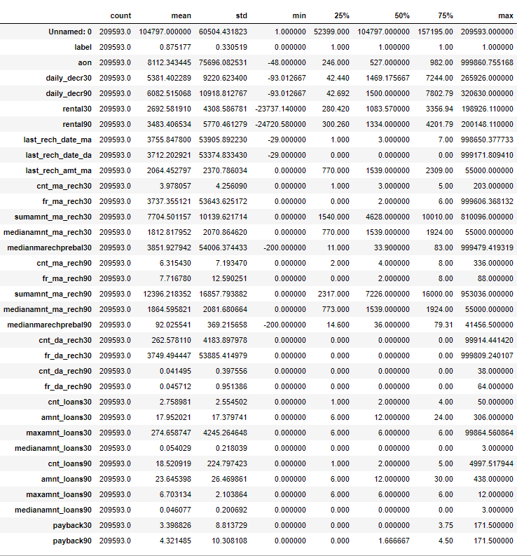
Analytical Problem Framing
From the above statistical summary of the above part of the dataset, we can see that the min value is negative which is not even possible for most of the features like daily recharge and main account balance, and last recharge can't be negative.
We created multiple group based on min, 25% to 75%, above 75% and we compared it VS payback within 5 days.
We identified the outliers for features whose Z-score>3, and then did mean imputing and also applied cube root to bring the data closer to distribution.
We checked the correlation of the independent and dependent features and dropped the negative and less important features with the help of correlation matrix

Slide 4
Data Pre-processing Done
We created multiple groups based on min, 25% to 75%, above 75% and we compared it VS payback within 5 days.
We identified the outliers for features whose Z-score>3, and then did mean imputing and also applied cube root to bring the data closer to distribution.
We checked the correlation of the independent and dependent features and dropped the negative and less important features with the help of correlation matrix.
Applied SMOTETomek, to balance the dataset as the dataset was imbalanced dataset.
Applied StandardScaler to our dependent features.
Applied various machine learning model and compared it.
Applied hyper tunning several models, but couldn’t achieve much better results.
Saving final predictions in file.csv format

Slide 5
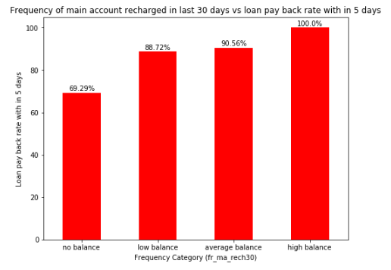
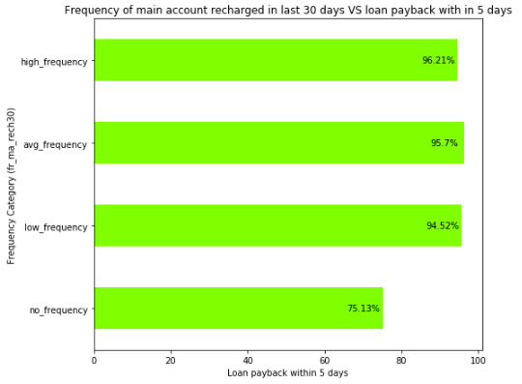
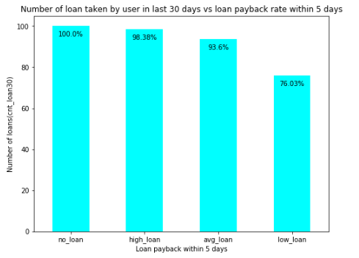
Data Inputs- Logic- Output Relationships
From the above we can see that users with high balance always pays back the loan within 5 days and average and low category only 9% - 12% users failed to payback the loan within 5%, and users with zero balance around 30% users are not paying the loan back within 5 days.
we can see there are no 100% rate in any frequency group to payback the loan within 5 days, and all average low and high frequency have at least 6% to 4% users didn't payback the loan within 5 days. Coming to user have no frequency 25% users didn't payback the loan with in 5 days, till now we can see that users with no balance and no frequency are costing huge losses.
we can see that majority user who took high loans in last 30 days are more likely to payback within 5 days and 1.62% users failed to payback within 5 days, and among average loan user 7% users failed to pay back the loan within 5 days, and users with low loan have 24% didn't payback as expected might be defaulted.

Slide 6
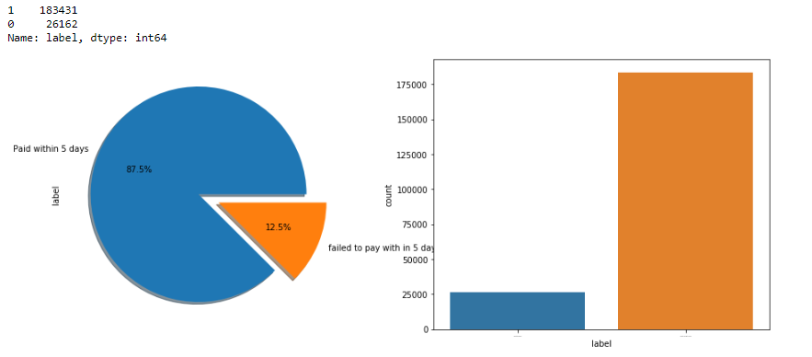
Model/s Development and Evaluation
Identification of possible problem-solving approaches (methods)
From the above we can see that the data set is highly imbalanced dataset, so applied SMOTETomek to balance the dataset.

Slide 7
Model/s Development and Evaluation
Testing of Identified Approaches (Algorithms)
KNN = KNeighborsClassifier()
XGBC=xgb.XGBClassifier()
LR=LogisticRegression()
DT=DecisionTreeClassifier()
GNB=GaussianNB()
RFC=RandomForestClassifier()
GBC=GradientBoostingClassifier()
ABC=AdaBoostClassifier()
ETC=ExtraTreesClassifier()

Slide 8
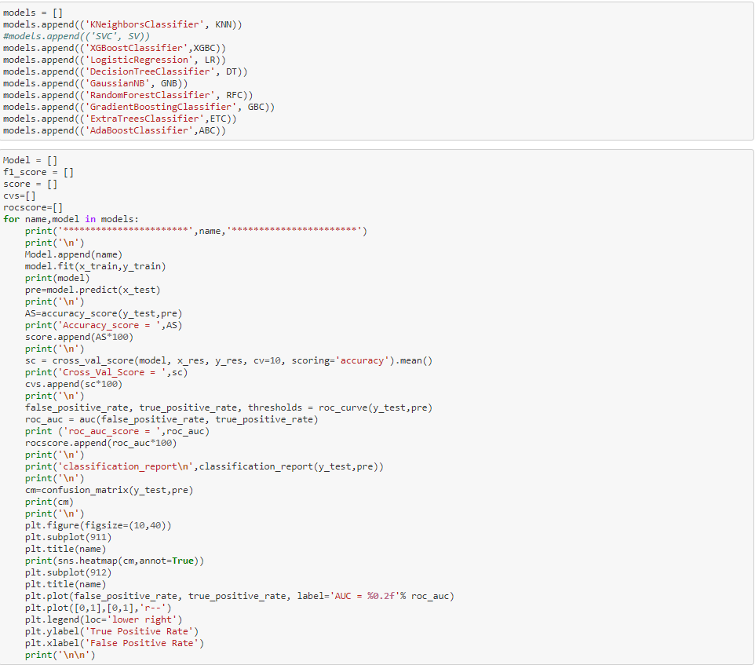
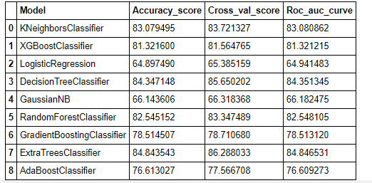
Model/s Development and Evaluation
Run and Evaluate selected models
Key Metrics for success in solving problem under consideration
From the above we can see that out of all Decision tree and Extra Tree classifier worked better and as per ROC_AUC_Curve Score we should select Extra Tree Classifier.

Slide 9
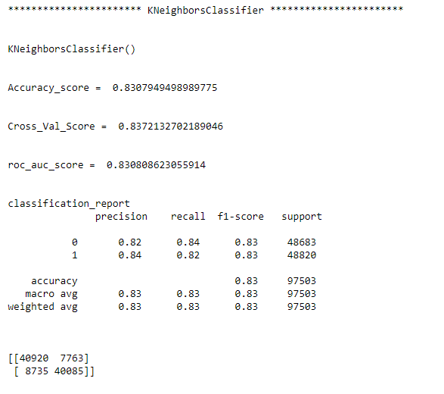
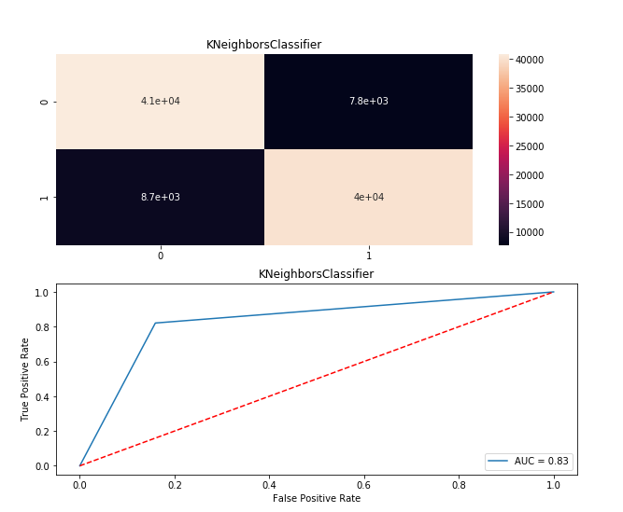
Model/s Development and Evaluation
Visualizations

Slide 10
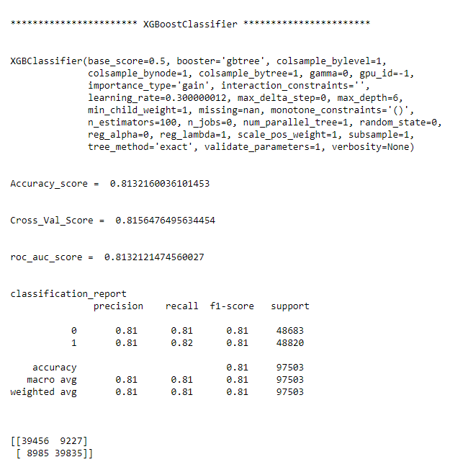
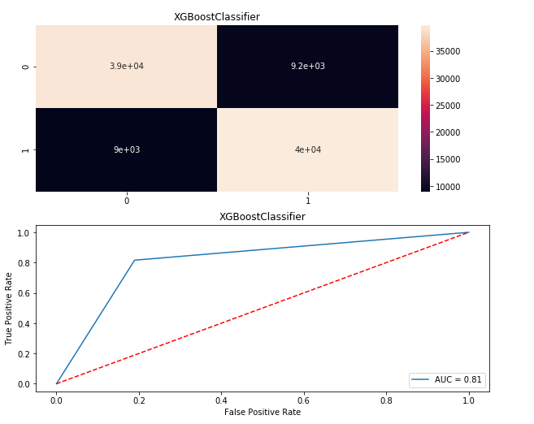
Model/s Development and Evaluation
Visualizations

Slide 11
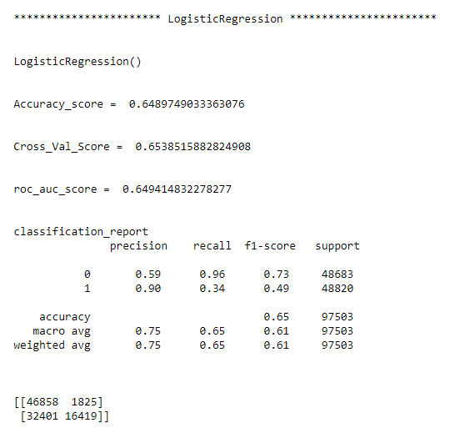
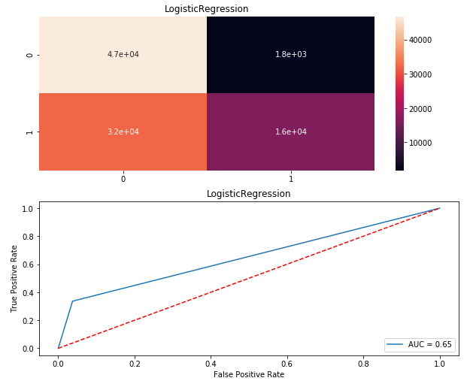
Model/s Development and Evaluation
Visualizations

Slide 12
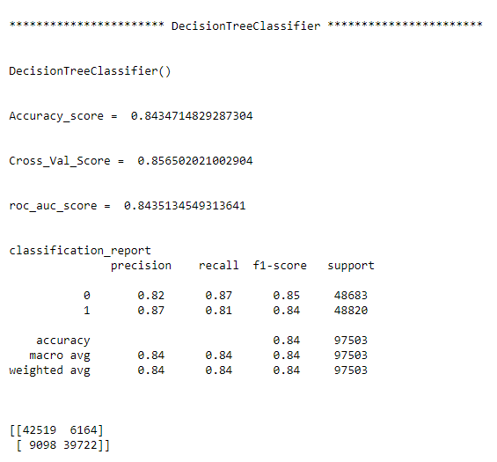
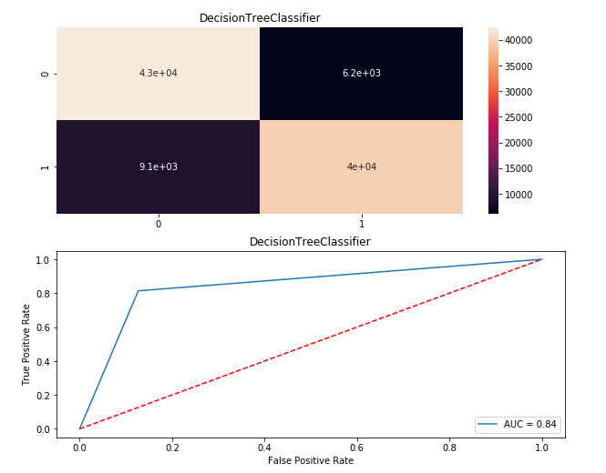
Model/s Development and Evaluation
Visualizations

Slide 13
CONCLUSION
Key Findings and Conclusions of the Study
From the whole evaluation we found that the MFIs have provided loan to the user who have no recharge or balance in their account which needs to be stopped as 30% defaulted user are from that type, and few high frequency loan takers and among users maintaining high balances are absorbed that 8% to 10% users are defaulted and some SMS altering notification before the deadlines can play a major role, in reducing the default rate.
Limitations of this work and Scope for Future Work
Machine Learning Algorithms like SVC and LinearSVC took enormous amount of time to build the model.
One of the limitations to my approach in comparing the models is that as it run all the models on the same time, so if we want to make changes or implement any experiments, all models runs again unnecessarily, so need to define a function for evaluation metrices and pass each algorithm, so that we can manual tune and play with it more.
We could have experimented more with increasing the components of the PCA and could have tried opting RandomOverSampler instead of SMOTETomek, and we could have use log imputation over mean imputation, these might have affected the resulting matrices, but as hyperparameter tunning and SVC model building took most of the time.

